Slide 1
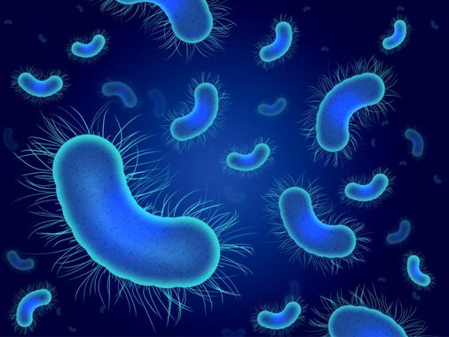
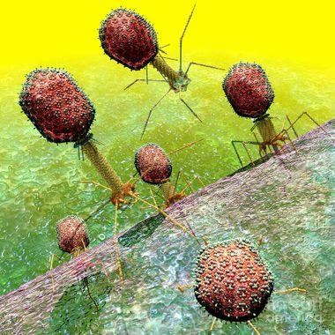
Bacterias and viruses of dataset:
duplicates and outliers

Slide 2
Duplicate rows
Duplicate rows can be a real pain.
If there is no need for them, they introduce bias in our dataset, and can be problematic for some algorithms.
A fast check and clean can free you from a lot of headache and work later.
They can arise from sensors that produce more data, defects in communication, but also from people that “work hard” and produce more measure.

Slide 3
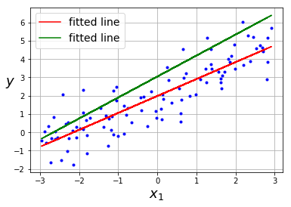
Duplicate rows
You cannot spot duplicate rows with scatter plot.
But they can heavily influence your result.
(here I centuplicate two points randomly)
(which one is the correct one?)

Slide 4
Duplicate rows
TWO kinds:
identical rows
multiple (independent?) observation of the same thing. (example multiple person have valued the quality of a film)
In the first case you should just eliminate the duplicate rows.
In the second you should perform retain the mean (median) of the observations

Slide 5
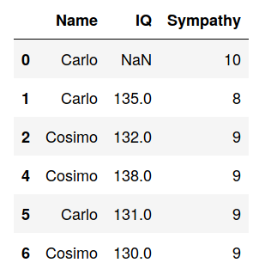
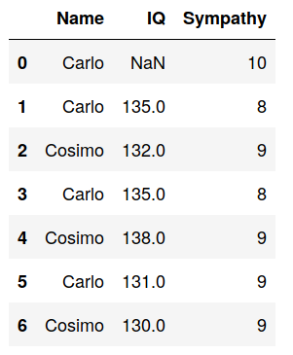
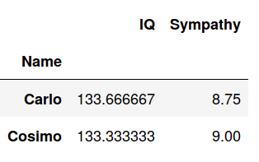
Duplicate rows
Eliminate duplicates
Eliminate duplicates
Group by Name performing the mean

Slide 6
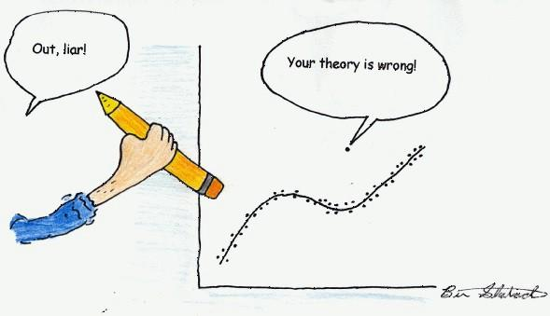
Outliers
“In statistics, an outlier is a data point
that differs significantly
from other observations”
What means differs significantly?

Slide 7
Outliers
Depending on the case of study there can be several causes of outliers:
Broken sensors
Errors in copy and paste
Errors in writing 1000 -> 10000
Human errors in general
We should take care that sometimes abnormal data are not errors, but instead real data. Maybe even the more interesting part of the data!
It is an axiom of business management that "80% of sales come from 20% of clients"
(the richest one typically).
Litt: “The Black Swan: the impact of the highly improbable”

Slide 8
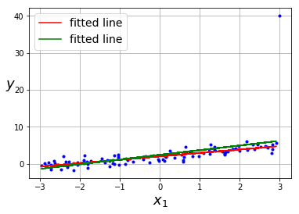
Effects of outliers
Outliers induce bad fittings.
How bad?
Do you think the difference here
is big?

Slide 9
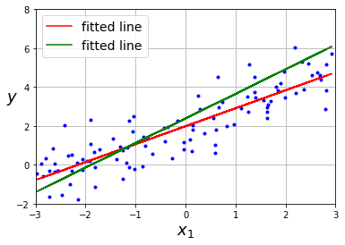
Effects of outliers
Of course it is very bad!
That single outlier changed drastically our fit.
We couldn’t see before because we were
plotting also the outlier!
Excluding the outlier we can clearly see the
“damage” it caused on our fit.

Slide 10
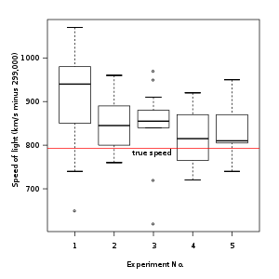
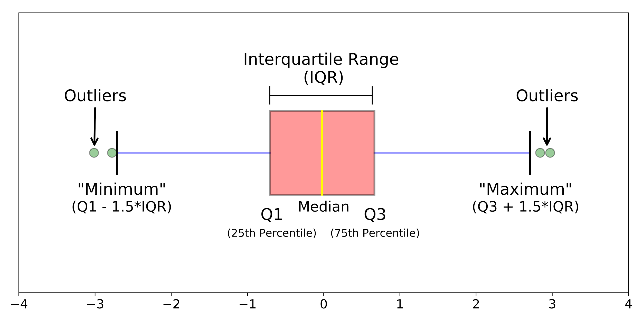
Box plot (I am not fan of)
Points outside the whiskers are about 3 standard deviations away from the median.
The probability for a gaussian is about 0.7% (so not impossible especially in big data )
However isolated point far away from the whiskers are usually labelled as outliers. Note that in Genomics only points 6 standard deviations away from the mean are considered outliers ;)

Slide 11
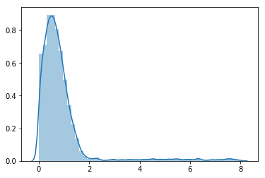
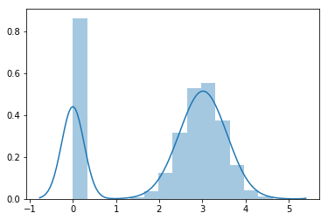
Plot the distribution
plotting the distribution is not useful for locating single isolated outliers but can give the possibility to spot more subtle (or giant!) malicious things.

Slide 12
Impossible numbers
Particular attention should be taken when there are values that are not physically possible.
For example negative mass, height, age, etc.
Be aware that when you have a broken sensor that gives always wrong data this will not be signaled as outliers!
To check for this you can simply look to the dataset info.

Slide 13
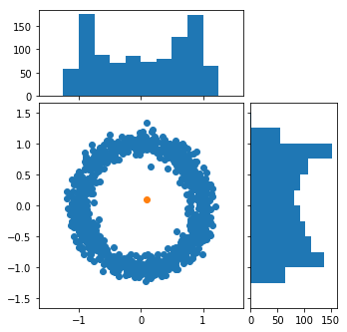
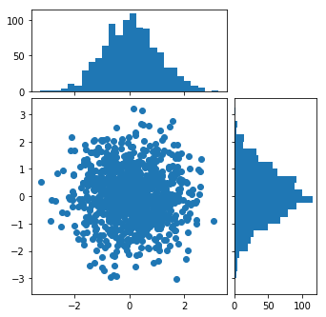
Outliers in 2D
Clearly that point it is an outliers but we cannot spot it just
using 1D properties!

Slide 14


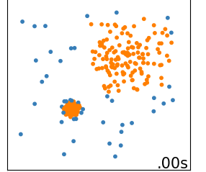
Local outlier Factor (Unsupervised ML! Wuhu!)
This model has an hyperparameter: the number of neighbour=N
The model is quite complicated to be explained in detail.
In short it calculate the mean distance between a point and his N neighbours and compare it to the same quantity calculated for the same N neighbours.
If this value is too large the point is labelled as an outlier.
Is not good on the points located on the border of a cluster.
From this the adjective Local.
ATTENTION: since we are dealing with distances, you should normalize your features

Slide 15
Pro and Cons
Lazy learner.
Curse of dimensionality. (PCA?) Which other algorithm of
Needs for rescaling. Supervised learning you
Only one hyper-parameter studied it resemble? (although difficult to estimate) (easiest question ever!?!)
Robust to rotations in feature space. Since is local is robust to huge disparities in clusters size. You shoud use it twice

Slide 16
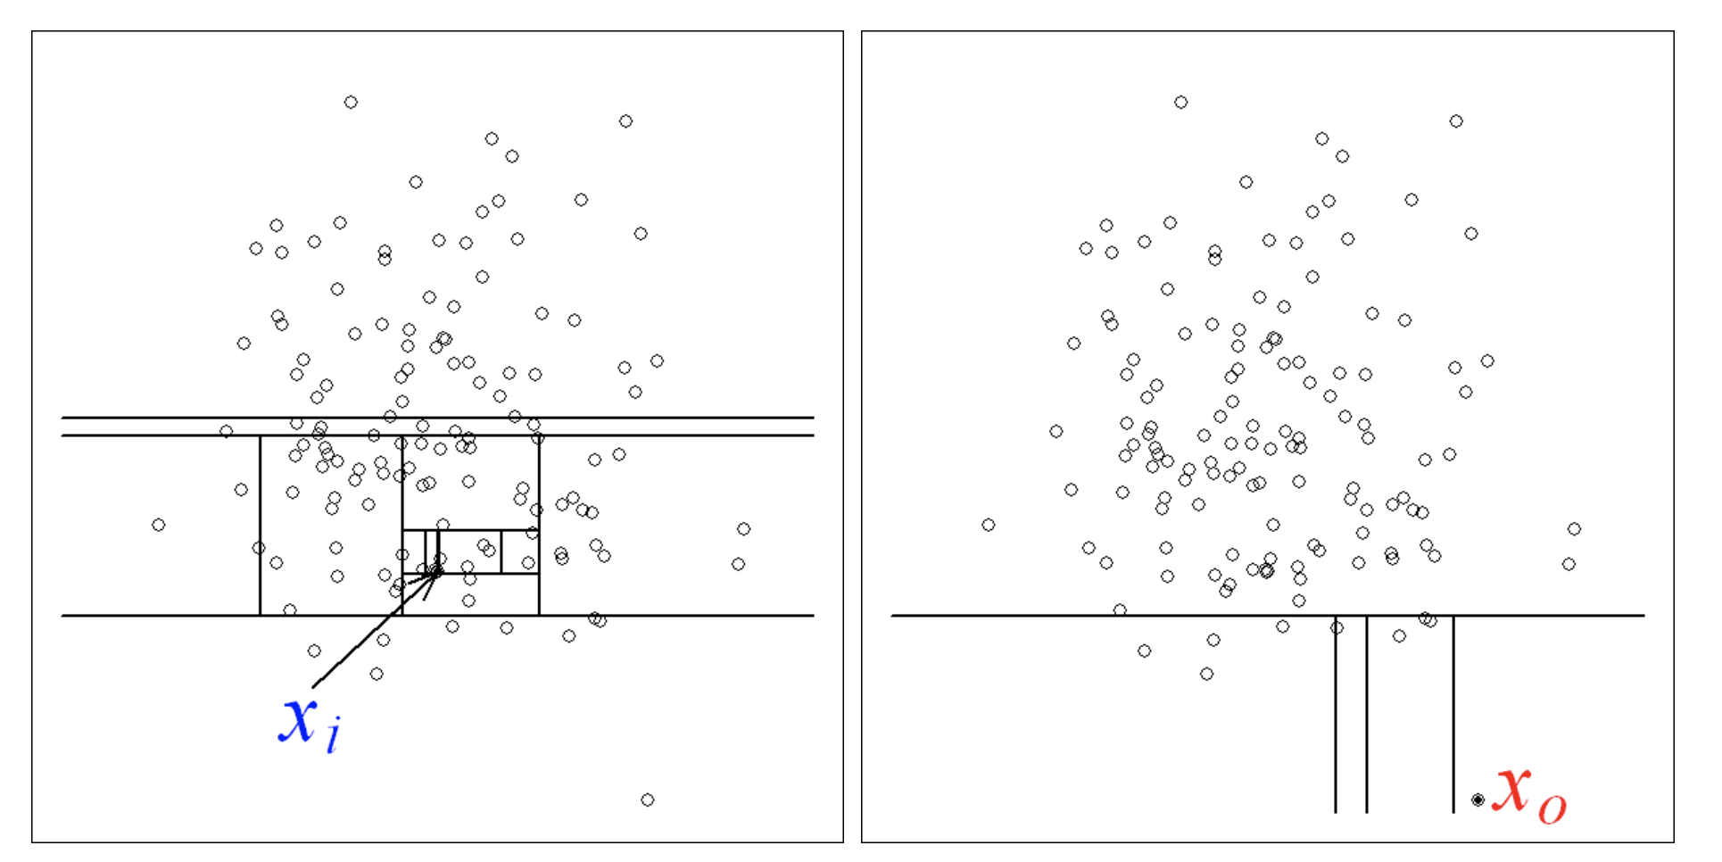
Isolation forest (Again Unsupervised ML! Wuhu!)
Draw a subset of psi points from the dataset. Perform random cuts between max and min of features chosen randomly.
Keep until you isolate all points in the subset. Repeat several times and make statistics.
The average number of cuts, necessary to isolate a point is related to how much the point is an outlier.

Slide 17
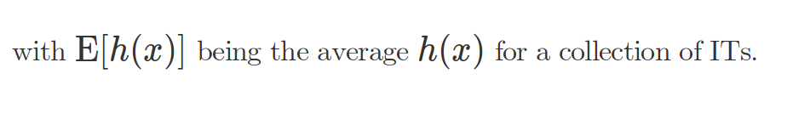
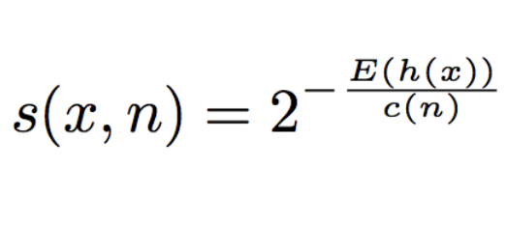
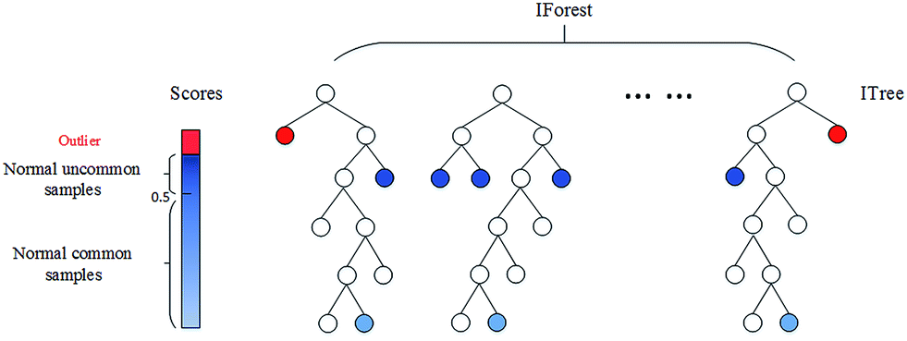
Isolation Forest algorithm
An outlier score is produced
You can use this outlier score
for eliminating the outliers.
And c(n) the average length in the ITs
Actually in SKlearn: S_SK=-(S_original-0.5)

Slide 18
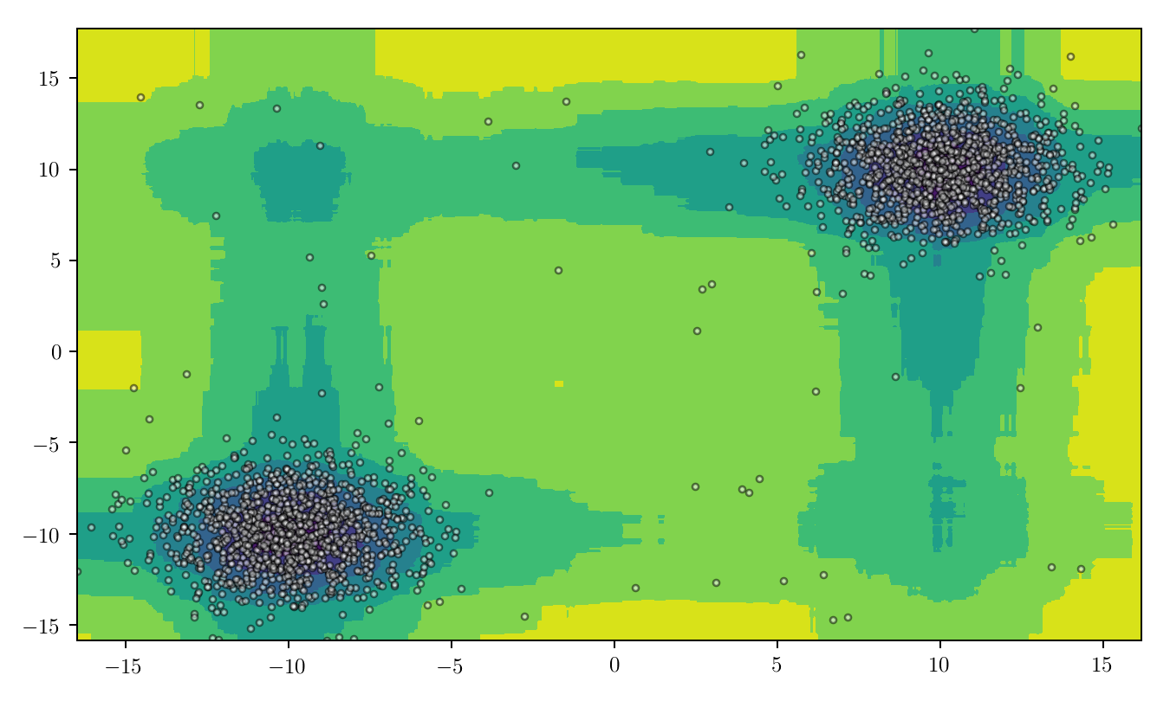
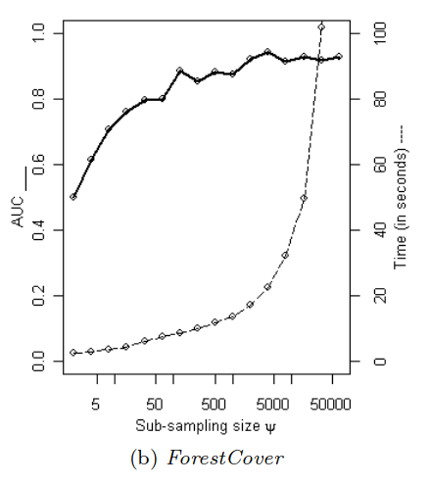
Isolation forest hyper-parameters
Note, using the algorithm maybe you did not sampled all the points, actually at max you sampled n*t with, n being the number of samples and t number of trees
But using all the ITs (an IF) you are able to construct an heat map of “outlierness” for all possible points in the feature space. (just as the RF. you can also random sample features just as the RF.) Increasing n the computer time increase not linearly. n=256 found by Liu et all to be good for a wide range of cases. t=100 is enough.
Liu, F. T., Ting, K. M., & Zhou, Z. H. (2012). Isolation-Based Anomaly Detection. ACM Transactions on Knowledge Discovery from Data, 6(1), 1–39. https://doi.org/10.1145/2133360.2133363

Slide 19
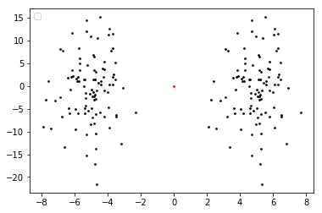
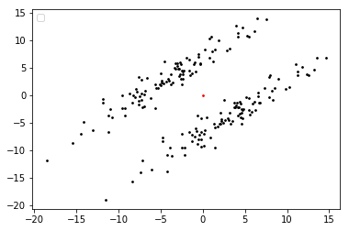
Pro and Cons
There is no need of scaling the values in the feature space.
Few hyper-parameters! Easy to optimize and robust and FAST!
Susceptible to rotations. (someone can tell me why?)
With huge disparity in clusters size, small clusters can be labeled as outliers, (someone can tell me why?)
Eager learner (model does not have to store all the dataset)

Slide 20
Lets go to the code!

